Slide 1
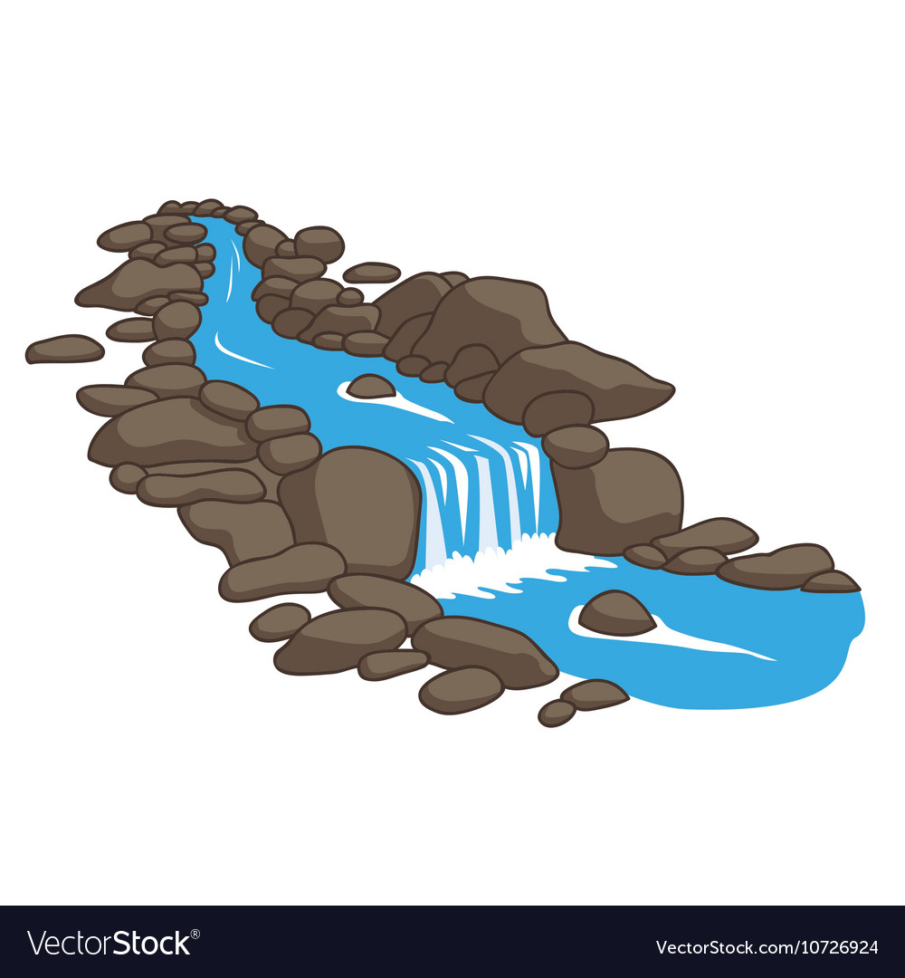
Course Introduction
Geo-hydro-informatics
for
Land and Water Resources

Slide 2
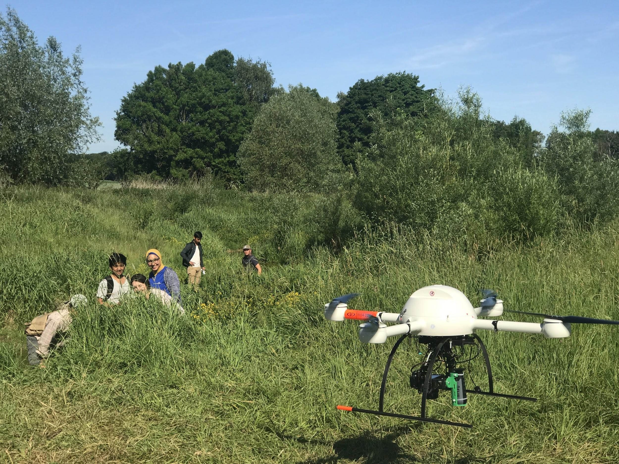
Er. Mahesh Thapa Geomatics Engineer mahesh100thapa@gmail.com Undergraduate in Geomatics Engineering, Kathmandu University 2011 Thesis : “Lake Morphometry and Hydrological Modeling of Begnas and Rupa Lakes’ Watersheds M.Sc. In Geospatial Technologies (Erasmus) University of Jaume I, Spain | University of Muenster, Spain Thesis : “Transforming Texts to Maps: Geovisualizing topics in texts” Project : "Determination of Surface Velocity of a River using Videos captured from Unmanned Aerial System (UAS)"
Notes:
Notes

Slide 3
Today’s Objective
Justifying the need of this course
Brief elaboration on course
Breaking into the syllabus
Discussion on Class Logistics

Slide 4
Why this course?
We study, investigate to solve a problem or make things better.
This course provides you with the fundamental and generic theoretical understanding and technical skills regarding geoinformation that would serve you in your higher aim of being a Land and Water Resource professional.
With analogy to carpenter: if carpentry teaches you about wood and how to acquire,store, process, use it and then provides you with craftsmanship about carpentry, then this course provides you with theoretical knowledge about geographic phenomena and how to use information technology to acquire, store, process, disseminate it.

Slide 5
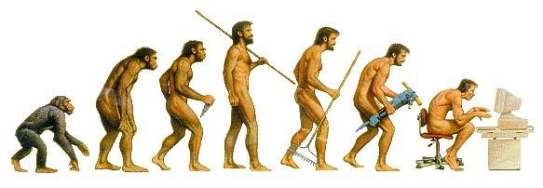
Why informatics ?
Why geo-informatics?
Why geo-hydro-informatics?
The rapid development of information technology has transformed the traditional ways of information processing.
The emphasis is to use information technology to do the difficult and repetitive tasks so that scholars can focus on improving the overall workflow.
Notes:
The way we perceive and process the information has been digitized. Eg: Globes and Hardcopy maps to Google Earth and digital maps

Slide 6
Why informatics ?
Why geo-informatics?
Why geo-hydro-informatics?
Approximately 80% of information is geospatial.
Processing of geospatial information is different than processing non-spatial information. It requires special (geospatial) software that has capability to process geospatial information.

Slide 7
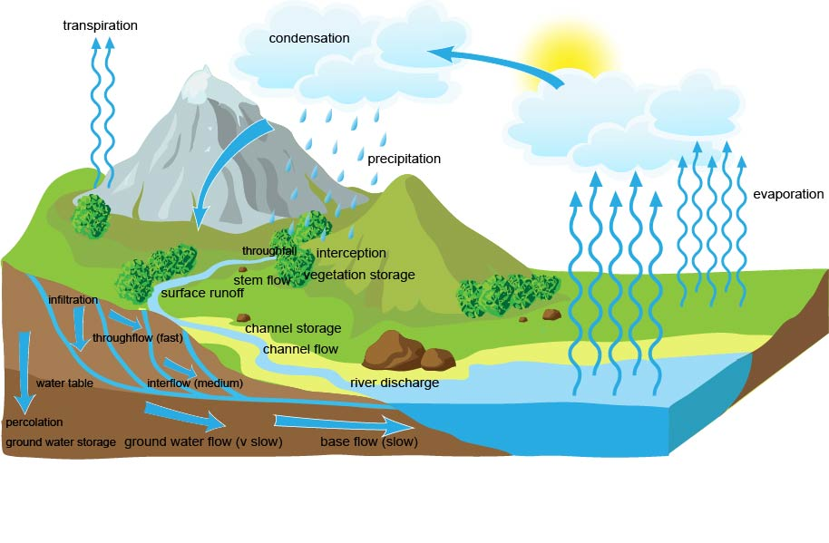
Why informatics ?
Why geo-informatics?
Why geo-hydro-informatics?
Geography provides context/background to water related phenomena with geography exerting a massive influence to these phenomena.
Utilizing the gallery of geospatial tools and techniques helps to efficiently process and better understand water relevant phenomena.

Slide 8
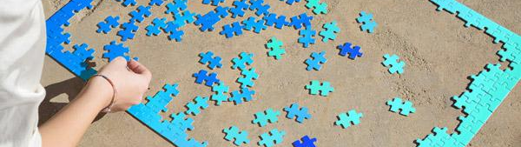

Course Outline
Core 3: Geo-Hydro-Informatics for Land and Water Resources (2-0-2) Credit: 4 Hours Year/Semester: I/I Electromagnetic spectrum; Energy interactions; Platforms and remote sensing sensors: Photographic camera, scanners, earth resources satellites, active and passive microwave sensors; Digital image processing: Image rectification, image enhancement, image classification and accuracy, Image interpretation. Introduction to GIS; Map Projections and Coordinate Systems; GIS Data Formats: Vector and raster data, TIN; GIS Data Input: digitizing, remote sensing, field data and GPS; Spatial Analysis: Vector and raster analysis, measurement, query, statistical surfaces (DEM); Accuracy and Errors; GIS Output: Map functions in GIS, map design and elements; GPS Fundamentals: GPS system, accuracy and sources of error in GPS. Case Studies: RS and GIS application in land and water resources systems. Laboratory Works: Digital database creation: point, line and polygon features; Data processing: dissolving and merging, clipping, intersection, union, buffering techniques; Spatial and attribute query; Spatial analysis and modeling; Digital terrain modeling; Application of GPS in field survey. Introduction to hydro-informatics: Data-driven modeling for water systems, Model classification, Models overview, Modeling accuracy, Introduction to machine learning and artificial intelligence; Hydro-informatics in water management: Information and communication technologies applied in hydro-informatics, Acquisition and processing of input data, Simulation models, Processing of model’s output data; Rainfall-Runoff models: HEC-HMSAWBM; SWAT; Modeling of water flow in open channels and floodplains: HEC-RAS; Ground water flow modeling: Processing MODFLOW; Pipe system flow modeling: Pipe Flow

Slide 9
Course Outline
Geo-Hydro-Informatics for Land and Water Resources
(2-0-2)
Geographical Information System
2. Remote Sensing
3. GPS
6. Introduction to hydro-informatics
4. Case Studies
7. Hydro-informatics in water management
5. Laboratory Works

Slide 10
Course Outline
Geo-Hydro-Informatics for Land and Water Resources
(2-0-2)
Remote
Sensing
Introduction to
hydro-informatics
Case Studies
Geographical Information System
Laboratory Works
Hydro-informatics
in water management
GPS

Slide 11
Course Outline
Geographical Information System
Geographical Information System
Introduction to GIS;
GIS Data Formats: Vector and raster data, TIN;
Map Projections and Coordinate Systems;
GIS Data Input: digitizing, remote sensing, field data and GPS;
Spatial Analysis: Vector and raster analysis, measurement, query, statistical surfaces (DEM);
Accuracy and Errors;
GIS Output: Map functions in GIS, map design and elements;
2. Remote Sensing
3. GPS
4. Case Studies
5. Laboratory Works
6. Introduction to hydro-informatics
7. Hydro-informatics in water management

Slide 12
Course Outline
2. Remote Sensing
Geographical Information System
Electromagnetic spectrum;
Energy interactions;
Platforms and remote sensing sensors: Photographic camera, scanners,
Earth resources satellites
Active and passive microwave sensors;
Digital image processing: Image rectification, image enhancement, image classification and accuracy, Image interpretation.
2. Remote Sensing
3. GPS
4. Case Studies
5. Laboratory Works
6. Introduction to hydro-informatics
7. Hydro-informatics in water management

Slide 13
Course Outline
3. GPS (Global Positioning System)
Geographical Information System
2. Remote Sensing
(GPS Fundamentals)
GPS system
Accuracy and Sources of error in GPS.
3. GPS
4. Case Studies
5. Laboratory Works
6. Introduction to hydro-informatics
7. Hydro-informatics in water management

Slide 14
Course Outline
4. Case Studies
Geographical Information System
2. Remote Sensing
RS and GIS application in land and water resources systems.
3. GPS
4. Case Studies
5. Laboratory Works
6. Introduction to hydro-informatics
7. Hydro-informatics in water management

Slide 15
Course Outline
Geographical Information System
4. Laboratory Works
2. Remote Sensing
Digital database creation: point, line and polygon features;
Data processing: dissolving and merging, clipping, intersection, union, buffering techniques;
Spatial and attribute query; Spatial analysis and modeling;
Digital terrain modeling;
Application of GPS in field survey
3. GPS
4. Case Studies
5. Laboratory Works
6. Introduction to hydro-informatics
7. Hydro-informatics in water management

Slide 16
Course Outline
Geographical Information System
6. Introduction to hydro-informatics
2. Remote Sensing
Data-driven modeling for water systems
Model classification,
Models overview,
Modeling accuracy,
Introduction to machine learning and artificial intelligence;
3. GPS
4. Case Studies
5. Laboratory Works
6. Introduction to hydro-informatics
7. Hydro-informatics in water management

Slide 17
Course Outline
Geographical Information System
7. Hydro-informatics in water management
2. Remote Sensing
Information and communication technologies applied in hydro-informatics
Acquisition and processing of input data,
Simulation models,
Processing of model’s output data;
Rainfall-Runoff models: HEC-HMS; AWBM; SWAT;
Modeling of water flow in open channels and floodplains: HEC-RAS;
Ground water flow modeling: Processing MODFLOW;
Pipe system flow modeling: Pipe Flow
3. GPS
4. Case Studies
5. Laboratory Works
6. Introduction to hydro-informatics
7. Hydro-informatics in water management

Slide 18
Some Course Logistics
Google Classroom (or other mutually agreeable alternative) for dissemination of course material.
Google Meet (or other mutually agreeable alternative) for online classes.
Communicate through WhatsApp (or other mutually agreeable alternative)
As a masters level course, students are encouraged to work themselves developing independent problem solving skills but also learn to work in teams. The courses will be re-modelled to include mini-projects.

Slide 19


Expectations
My Side
Your Side
Notes:
Teach Learn : Students among students. Students and teachers.

Slide 20
End of Session
Course Introduction
Geo-hydro-informatics for Land and Water Resources

